Slide 1

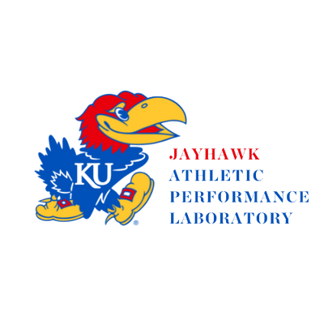

5-Minute Heart Rate
Recovery (HRR) App
Joe DeLeo | MSc, CSCS

Slide 2

Overview
Literature Review
Purpose
Limitations & Future Directions

Slide 3
Literature Review
Rowing is one of the original Olympic sports making its first appearance at the 1900 Paris Olympic Games.
Until 1976 only men’s events were included at the Olympics. Women’s rowing was added to the Olympic program at the 1976 Montreal Olympics.
In sports performance research female athletes have been greatly underserved. Often, the results of studies on male athletes are applied to female athletes’ training.
NBC Olympics (2024). Rowing 101 Olympic History. https://www.nbcolympics.com/news/rowing-101-olympic-history
Notes:
However, this was only at a distance of 1,000-meteres

Slide 4
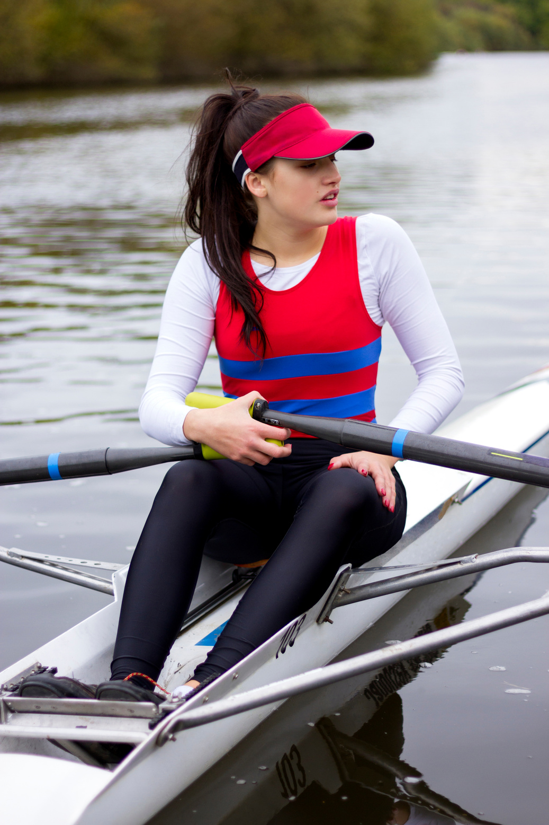

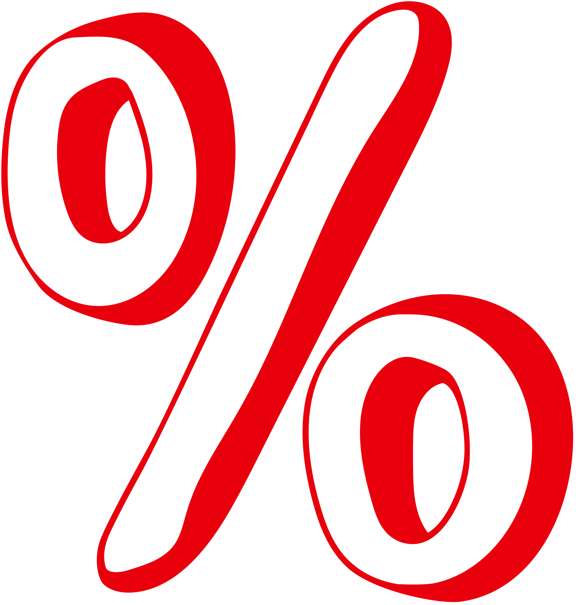
How many females participate in sport and exercise science research?
Cowley, E. S., Olenick, A. A., McNulty, K. L., & Ross, E. Z. (2021). “Invisible sportswomen”: the sex data gap in sport and exercise science research. Women in Sport and Physical Activity Journal, 29(2), 146-151.
Notes:
Cowley et al. (2021) conducted an exploratory study focusing on the ratio of male to female participants in sport and exercise science research. They found that out of 5,261 publications across six sport and exercise science journals between 2014-2020, only 6% focused exclusively on females.

Slide 5

High Volume Endurance Sport
U19 rowers train between 12-14 hours per week while elite level rowers train 22-25+ hours per week.
Arne, G., Stephen, S., & Eike, E. (2009). Training methods and intensity distribution of young world-class rowers. International journal of sports physiology and performance, 4(4), 448-460.
Tran, J., Rice, A. J., Main, L. C., & Gastin, P. B. (2015). Profiling the training practices and performance of elite rowers. International journal of sports physiology and performance, 10(5), 572-580.
Notes:
The only variable that was statistically significant in all 4 groups was power at 4 mmol/L.

Slide 6
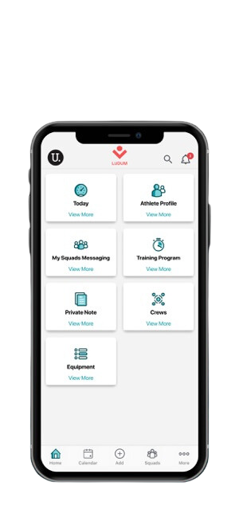

KU Women’s Rowing
Currently, KU Women’s Rowing utilizes a rowing management software system: Ludum
This allows them to track daily heart rate data on-water and on the rowing ergometer.

Slide 7
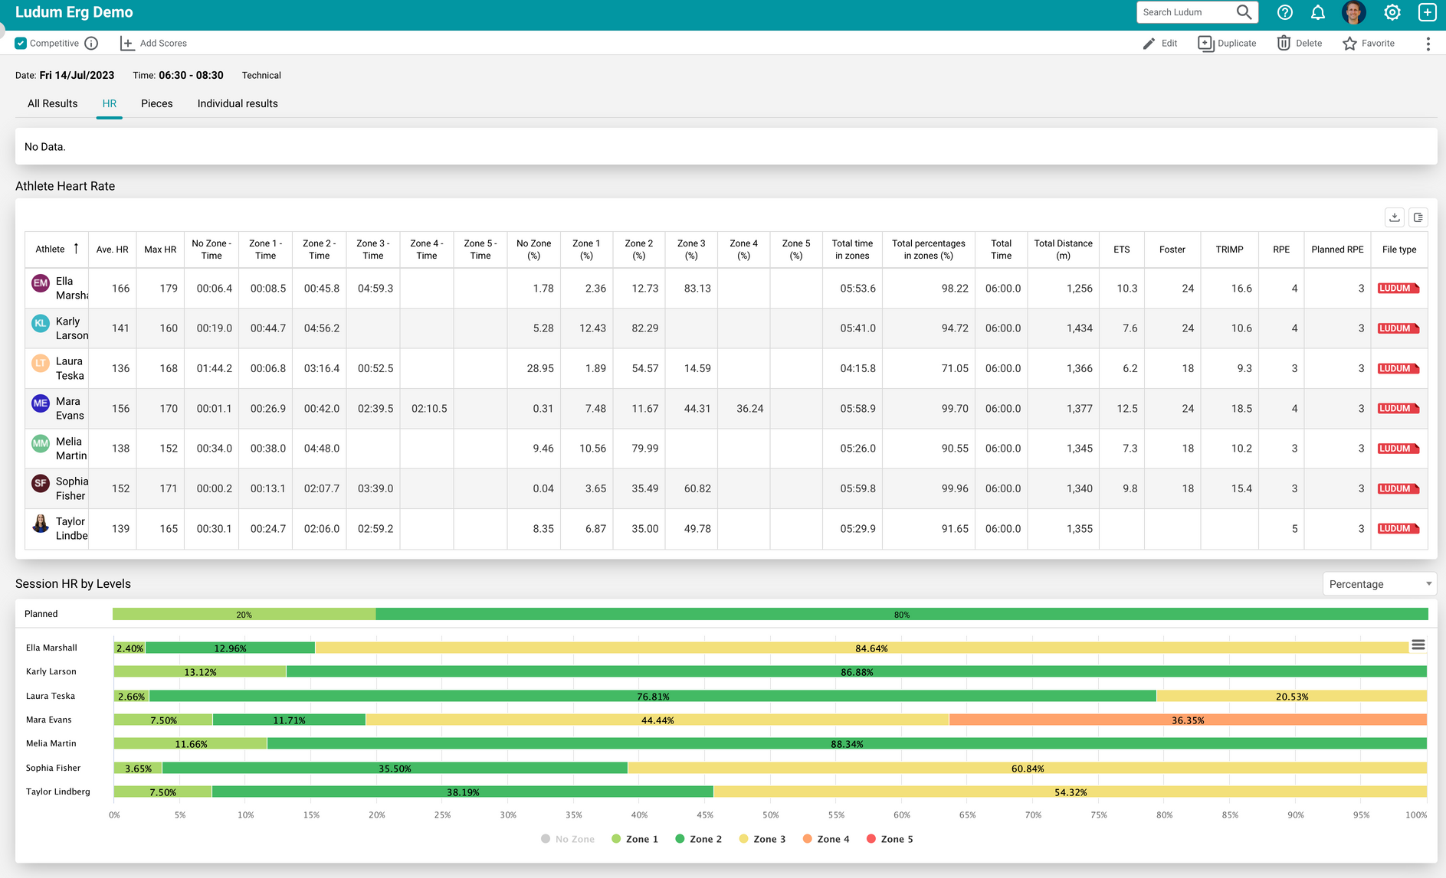

KU Women’s Rowing
While the platform allows tracking of individualized heart rate zones, it does not have a field based, rowing specific monitoring test.
Notes:
The only variable that was statistically significant in all 4 groups was power at 4 mmol/L.

Slide 8
Purpose
The purpose of the 5-minute HRR app is to provide rowers and coaches with a field-based athlete monitoring tool that can be easily and efficiently implemented with large teams.
This will allow coaches to monitor training load and if athletes are regressing in performance. This can help avoid injury/illness but also optimize performance
The concept of this app came from my work with USRowing’s Chief High Performance Officer. He uses the test with elite rowers, however they also have no streamlined way to capture and visualize the data.

Slide 9
5-Minute HRR Test
Rowers perform 5-minutes on the rowing ergometer at 50% of their 2k watts.
Variables collected include: Heart Rate at 5', Heart Rate Recovery at 1 and 2' and RPE. All other variables are calculated from these.
The 5-minute test was originally used with soccer players during their warm-up.
Thorpe, R. T., Strudwick, A. J., Buchheit, M., Atkinson, G., Drust, B., & Gregson, W. (2015). Monitoring fatigue during the in-season competitive phase in elite soccer players. International journal of sports physiology and performance, 10(8), 958-964.

Slide 10
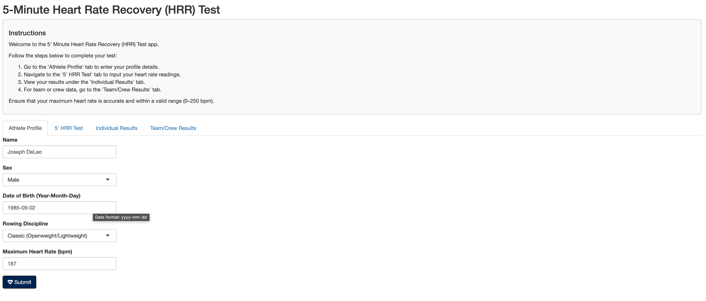
5-Minute HRR Test
Athlete Profile Screen

Slide 11
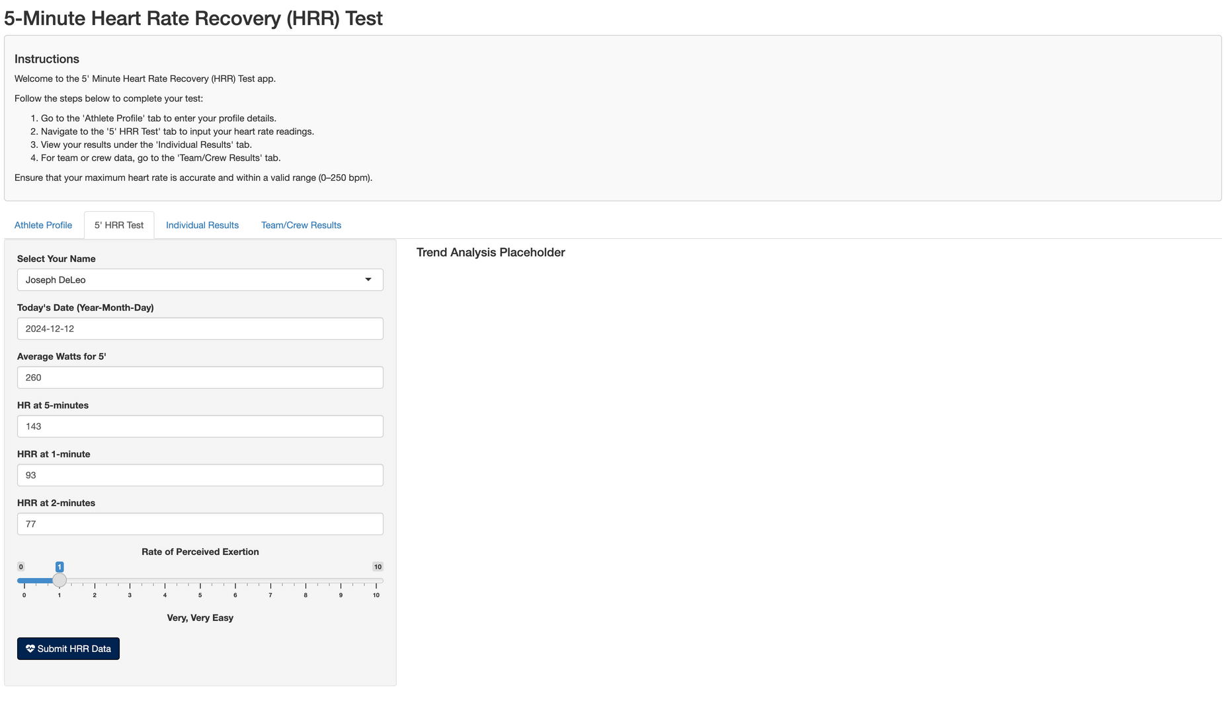
5-Minute HRR Test
5' HRR Data Entry Tab

Slide 12
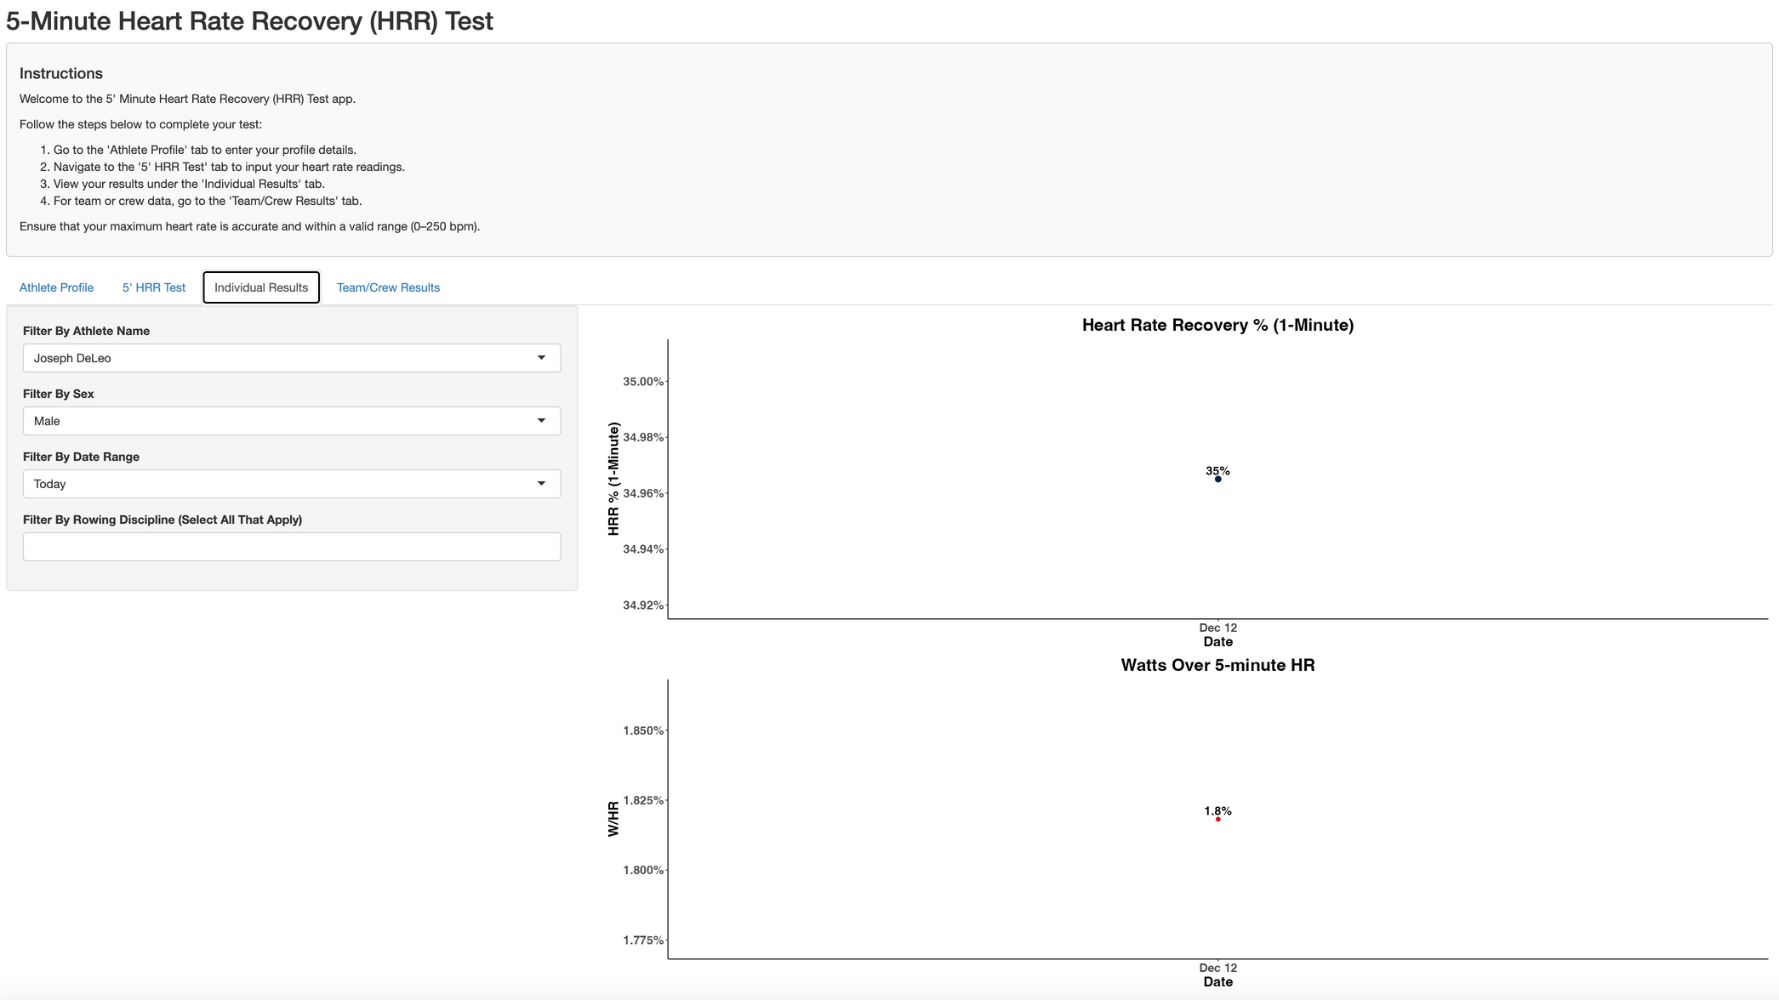
5-Minute HRR Test
Data View for ‘Current Date’

Slide 13
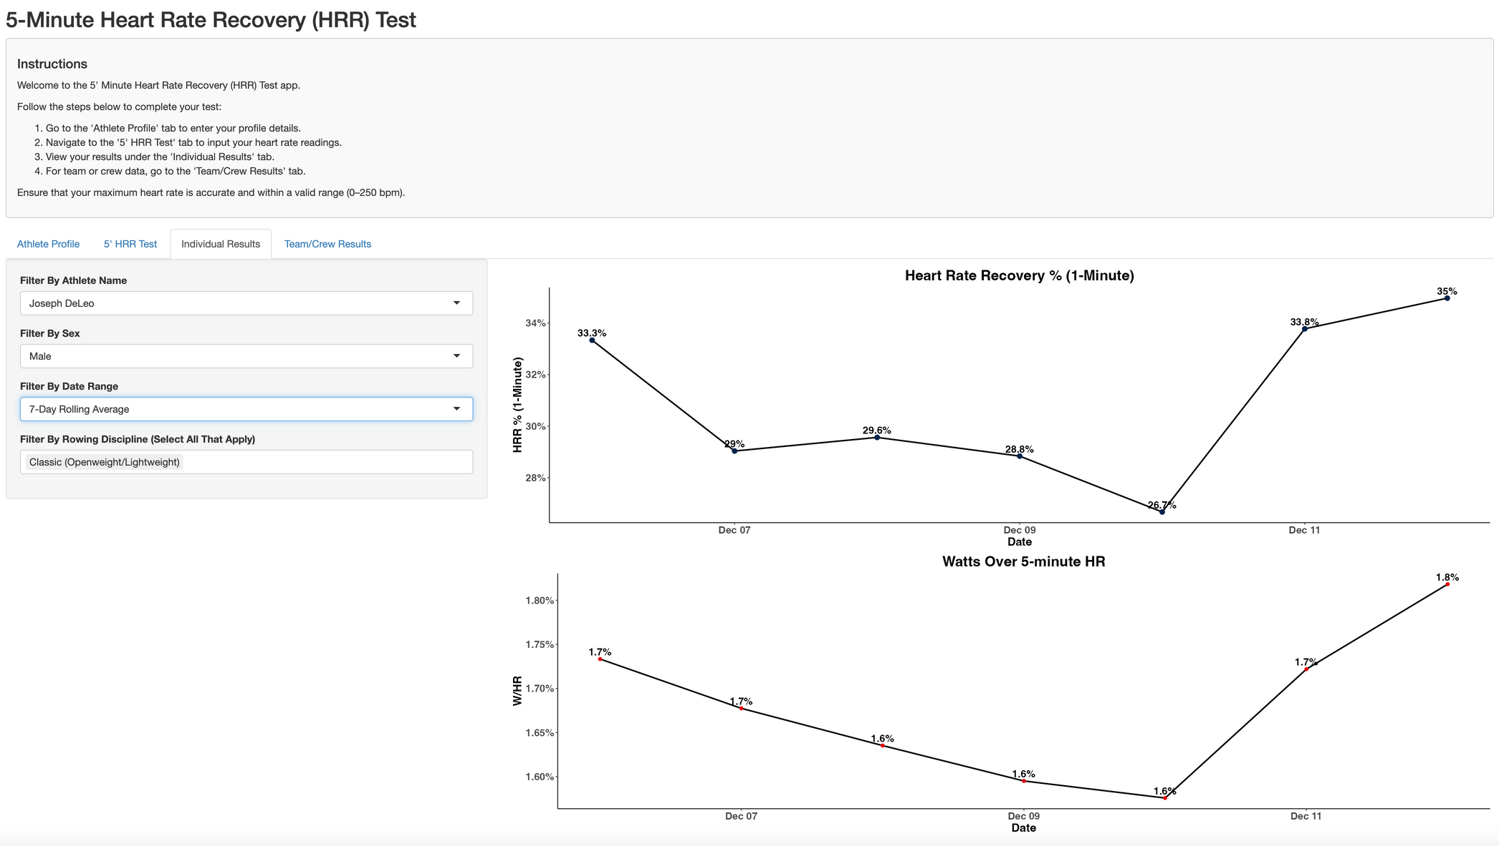
5-Minute HRR Test
Data View for ‘7-Day Rolling Average’

Slide 14
Limitations
Current app version saves data but it is only stored during the current session.
Team/Crew tab was not built out.

Slide 15
Future Directions
Enhance visualizations for individual and team/crew tabs.
Connect to external database to allow for data storage and athlete’s to create a username/password.
Conduct pilot testing prior to engage in a study with KU Women’s Rowing and USRowing.

Slide 16
Git Repository
https://github.com/JMDeLeo/data824.git

